Slide 1
How to Destroy a Laptop with Top Secrets
How GCHQ supervised The Guardian's destruction of machines storing Snowden's documents
@musalbas and @richietynan
Privacy International

Slide 2
Background
The Guardian had copies of Snowden documents in their London office.
  Stored on encrypted and airgapped machines in a secure room.
  Round-the-clock guards and a ban on electronics.
The Guardian was reporting on these documents.
The British government wasn't happy about this.
Notes:
A small team of trusted senior reporters examined Snowden's files in a secure fourth-floor room in the Guardian's King's Cross office. The material was kept on four laptops. None had ever been connected to the internet or any other network. There were numerous other security measures, including round-the-clock guards, multiple passwords, and a ban on electronics.
The government's response to the leak was initially slow – then increasingly strident. Rusbridger told government officials that destruction of the Snowden files would not stop the flow of intelligence-related stories since the documents existed in several jurisdictions.

Slide 3
Threats
Cabinet secretary (Jeremy Heywood) pressured The Guardian to return the documents.
  To conduct “forensics”. (Oliver Robbins, national security advisor)
  To strengthen the legal case against Snowden and The Guardian.
The threats harassment continued.
  Heywood: "We can do this nicely or we can go to law", "A lot of people in government think you should be closed down."
  Robbins: “If you won't return it [the Snowden material] we will have to talk to 'other people' this evening.”
Notes:
Days later Oliver Robbins, the prime minister's deputy national security adviser, renewed the threat of legal action. "If you won't return it [the Snowden material] we will have to talk to 'other people' this evening." Asked if Downing Street really intended to close down the Guardian if it did not comply, Robbins confirmed: "I'm saying this." He told the deputy editor, Paul Johnson, the government wanted the material in order to conduct "forensics". This would establish how Snowden had carried out his leak, strengthening the legal case against the Guardian's source. It would also reveal which reporters had examined which files.

Slide 4
Responding to threats
The Guardian had to protect itself, but continue to report on the documents, by destroying its London copy of the documents.
GCHQ wanted to inspect the material before destruction, destroy it themselves and then take the destroyed pieces.
  The Guardian disagreed.
Mutual agreement: The Guardian would destroy it themselves, under the supervision of GCHQ.
Notes:
With the threat of punitive legal action ever present, the only way of protecting the Guardian's team – and of carrying on reporting from another jurisdiction – was for the paper to destroy its own computers. GCHQ officials wanted to inspect the material before destruction, carry out the operation themselves and take the remnants away. The Guardian refused.

Slide 5
Destruction
GCHQ instructed the Guardian to buy angle-grinders, dremels (drills with revolving bits), and masks.
  GCHQ provided a degausser (destroys magnetic fields and erases data), as it was expensive.
GCHQ supervised the instruction process.
2 GCHQ technical experts recorded the process with their iPhones.
Notes:
Three Guardian staff members – Johnson, executive director Sheila Fitzsimons and computer expert David Blishen – carried out the demolition of the Guardian's hard drives. It was hot, sweaty work. On the instructions of GCHQ, the trio bought angle-grinders, dremels – a drill with a revolving bit – and masks. The spy agency provided one piece of hi-tech equipment, a "degausser", which destroys magnetic fields, and erases data. It took three hours to smash up the computers. The journalists then fed the pieces into the degausser.
Two GCHQ technical experts – "Ian" and "Chris" – recorded the process on their iPhones. Afterwards they headed back to GCHQ's doughnut-shaped HQ in Cheltenham carrying presents for family members, bought on their rare visit to the capital.
"It was purely a symbolic act," Johnson said. "We knew that. GCHQ knew that. And the government knew that," He added: "It was the most surreal event I have witnessed in British journalism."

Slide 6
Destruction video
http://www.theguardian.com/uk-news/2014/jan/31/footage-released-guardian-editors-snowden-hard-drives-gchq

Slide 7
Aftermath
Why did GCHQ supervise the Guardian to destroy in a specific way?
There could be a lot to learn from GCHQ about how to properly eradicate data from a device.
Many non-obvious components were destroyed, including components in the keyboard, trackpad, battery controller...

Slide 8
Trackpad controller
Before
After:
Destroyed serial flash chip.
Macronix MX25L2006E stores up to 2M-BIT.

Slide 9

Mac firmware updates

Slide 10
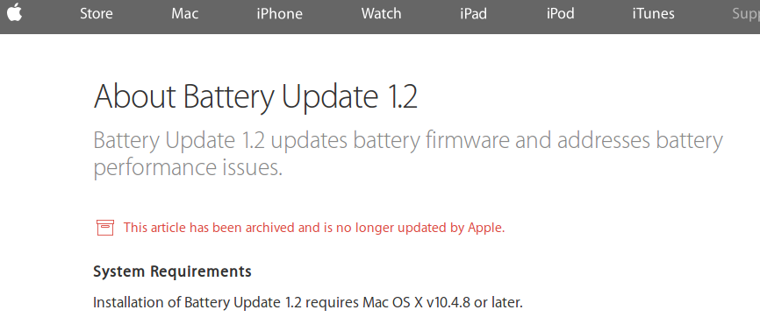
Mac firmware updates

Slide 11
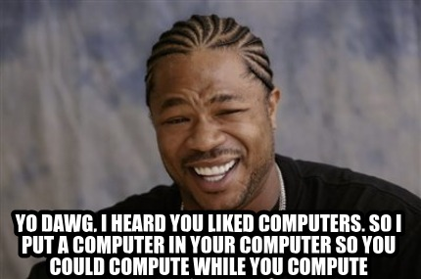
Xzibit's Iron Law of Computer Architecture
Via Dan Kaminsky 2014 Defcon talk.
Hard work is offloaded to hardware, which is really just another computer - with its own firmware and storage.
The biggest lie about your computer is that it's just one computer.

Slide 12

Is GCHQ trolling?
Joint Threat Research Intelligence Group (JTRIG)
  “The scope of the JTRIG's mission includes using "dirty tricks" to “destroy, deny, degrade [and] disrupt” enemies by “discrediting” them, planting misinformation and shutting down their communications.”
"It was purely a symbolic act," Johnson said. "We knew that. GCHQ knew that. And the government knew that." - Guardian staff member Paul Johnson
Was it a purely symbolic act from a technical standpoint?
GCHQ didn't intended for the destruction or the devices to be public; they originally just wanted the machines intact to conduct forensics.
Is GCHQ spreading disinformation?
  Maybe - probably not, but evidence suggests that destroying these chips is actually a good idea.

Slide 13
Claims
Claims by commentators after our original article about the destroyed hardware:
“Back when I worked for Convergys/Apple, one of the main things was we could not bring in our own peripherals to use. Mice, keyboard, etc. The issue is that one, in theory, could customize it for storage covertly and copy customer/client information.”
“I have destroyed the brand new iDevices of senior Government personnel because they plugged it into a classified network to charge it for less than a minute. The law is the law. I actually had a wall of digital devices we had drilled, degaussed etc.”
Notes:
Quote 1 is from someone who claims “it was previously my job (for 3 years) to investigate security breaches and destroy devices”.

Slide 14
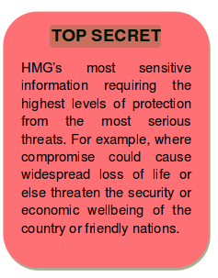
“Top secret”
What is the law?
A document from the Cabinet Office (“Government Security Classifications”) defines “Top secret” and its threat model in great detail.

Slide 15
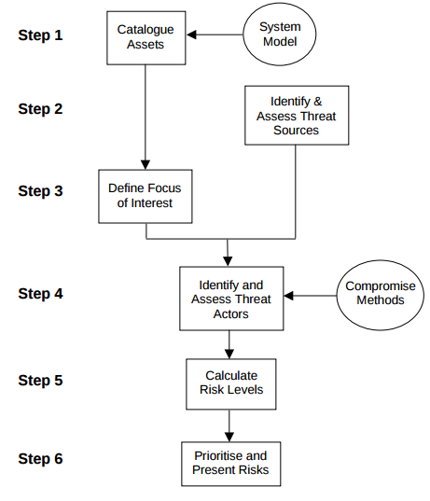
HMG IA Standard No. 1
By Communications-Electronics Security Group, a group within GCHQ.
A document for assessing technical risks to government information.

Slide 16
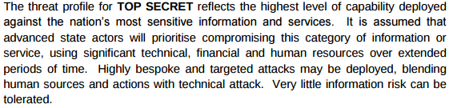
“Top secret” threat profile
From “Government Security Classifications”.

Slide 17
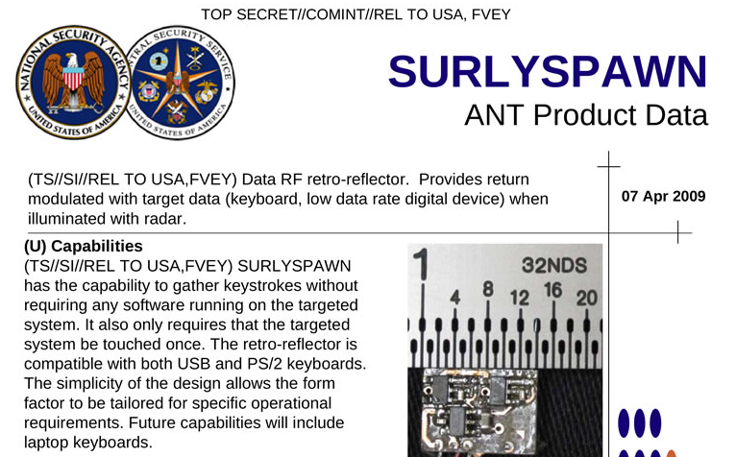
Implants from the NSA ANT catalog

Slide 18
GCHQ procedures
Documents that govern counter-compromise measures:
  HMG Information Assurance Note 5
    Data destruction standard used by the British government.
    I emailed GCHQ to ask nicely for a copy... they refused. :(
    “CESG's policy and guidance is only available to UK Public Sector organisations. Therefore we are not able to issue a copy of the document to you.”
    “Communications with GCHQ may be monitored and/or recorded for system efficiency and other lawful purposes.”
  Joint Services Publication 440
    Ministry of Defence 2,400-page restricted security manual.
    Leaked by WikiLeaks.

Slide 19
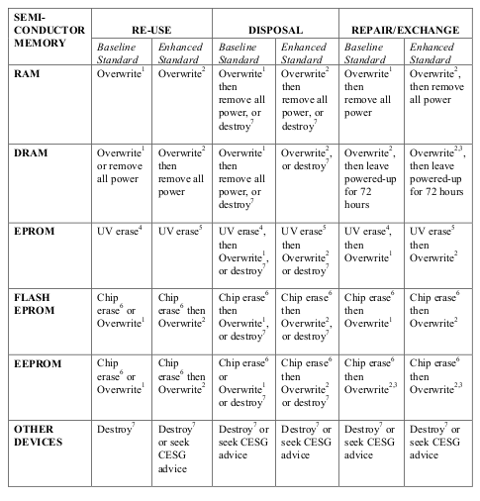
Joint Services Publication 440
“ERASURE OF PROTECTIVELY MARKED COMPUTER STORAGE MEDIA”
Footnote for 7: “Destroy – Disintegrate, incinerate, pulverise, shred or melt.”

Slide 20
Joint Services Publication 440
"The security measures in this chapter are aimed primarily to cover contacts made in CSSRAs and have been drawn up to protect the individual from action by FISs, extremist groups, investigative journalists and criminals."

Slide 21
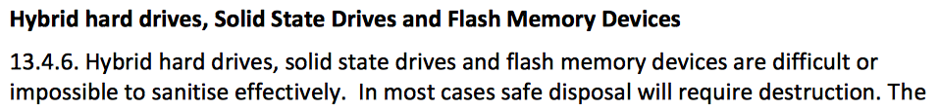
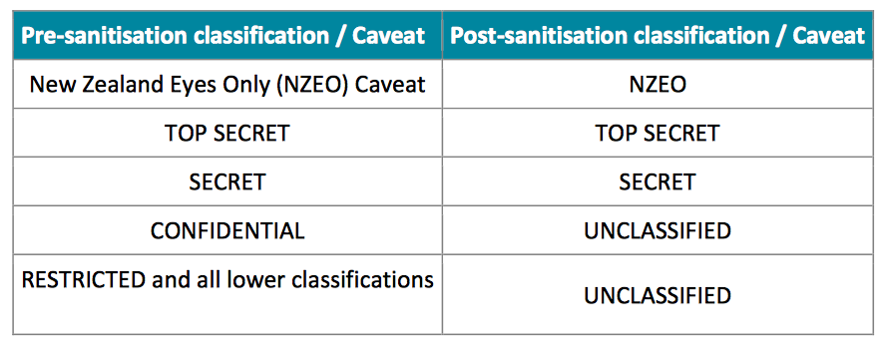
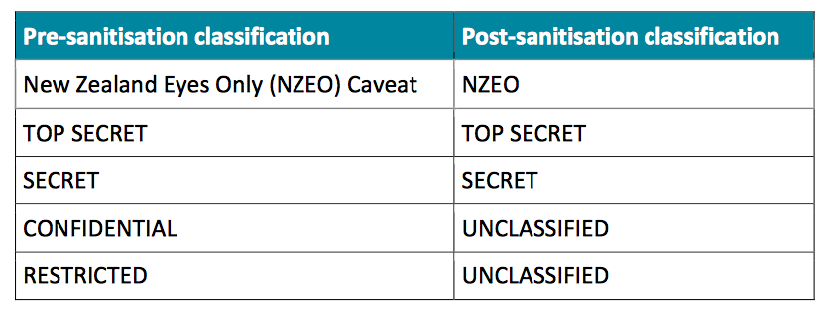
Top Secret Sanitisation – New Zealand
Volatile Storage e.g. RAM
Non-volatile Storage e.g. HDD
Same for SSDs and Hybrid drives, Flash, EPROM and EEPROM

Slide 22
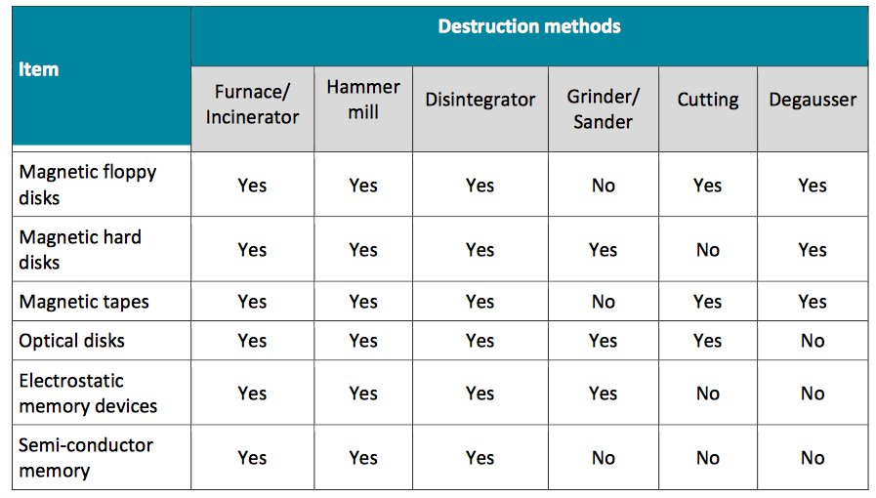
Top Secret Destruction – New Zealand

Slide 23
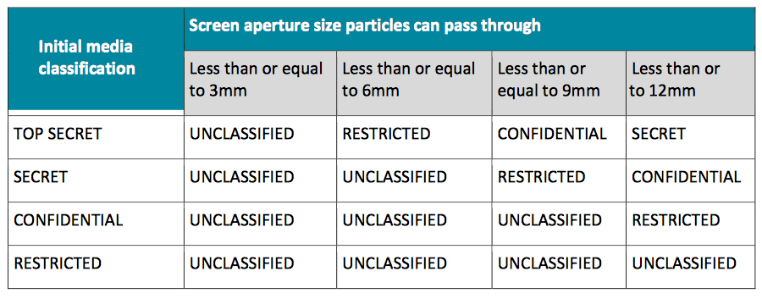
Top Secret Destruction – New Zealand

Slide 24
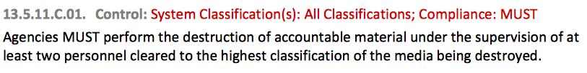
Top Secret Destruction – New Zealand

Slide 25
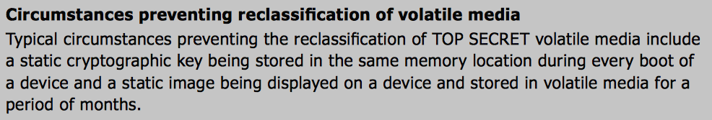
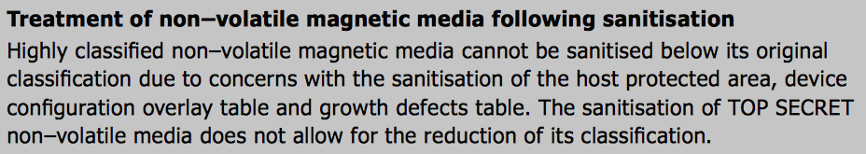
Top Secret Destruction – Australia

Slide 26
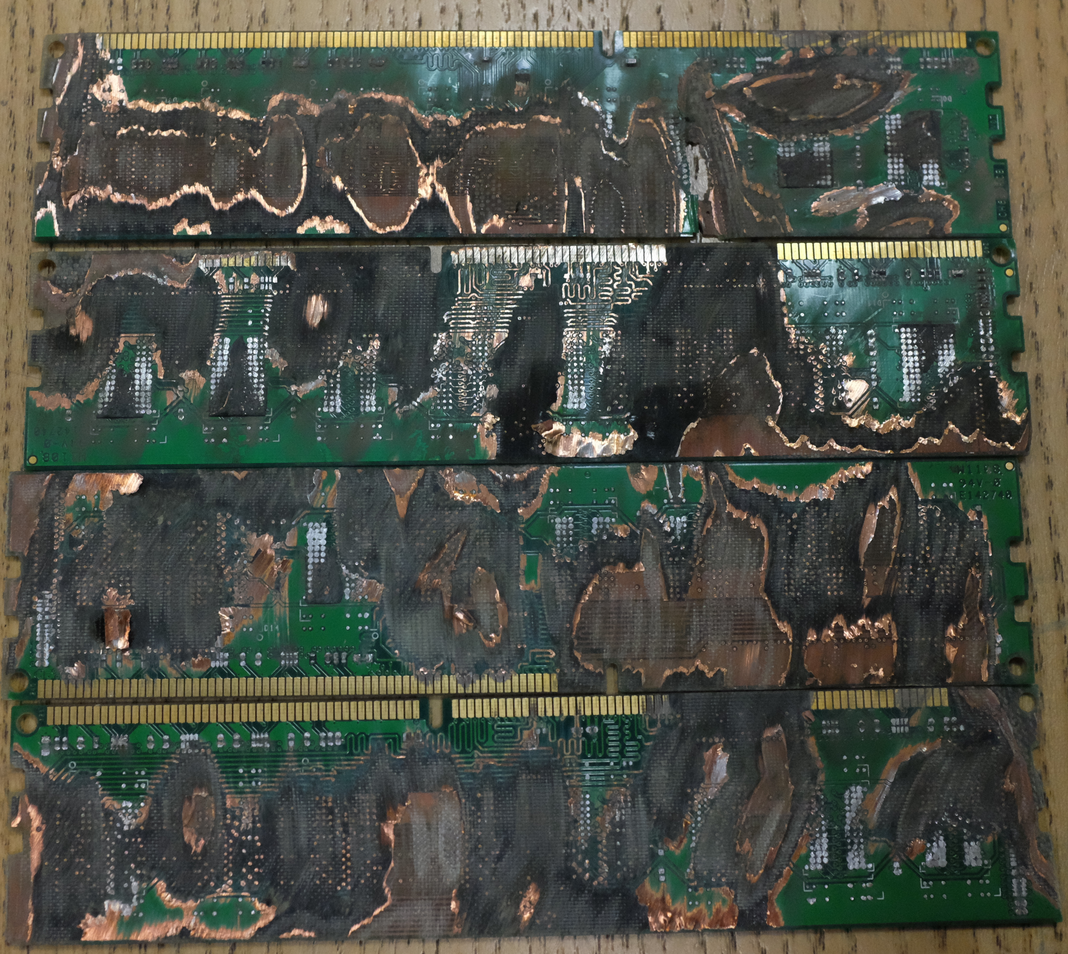
RAM

Slide 27
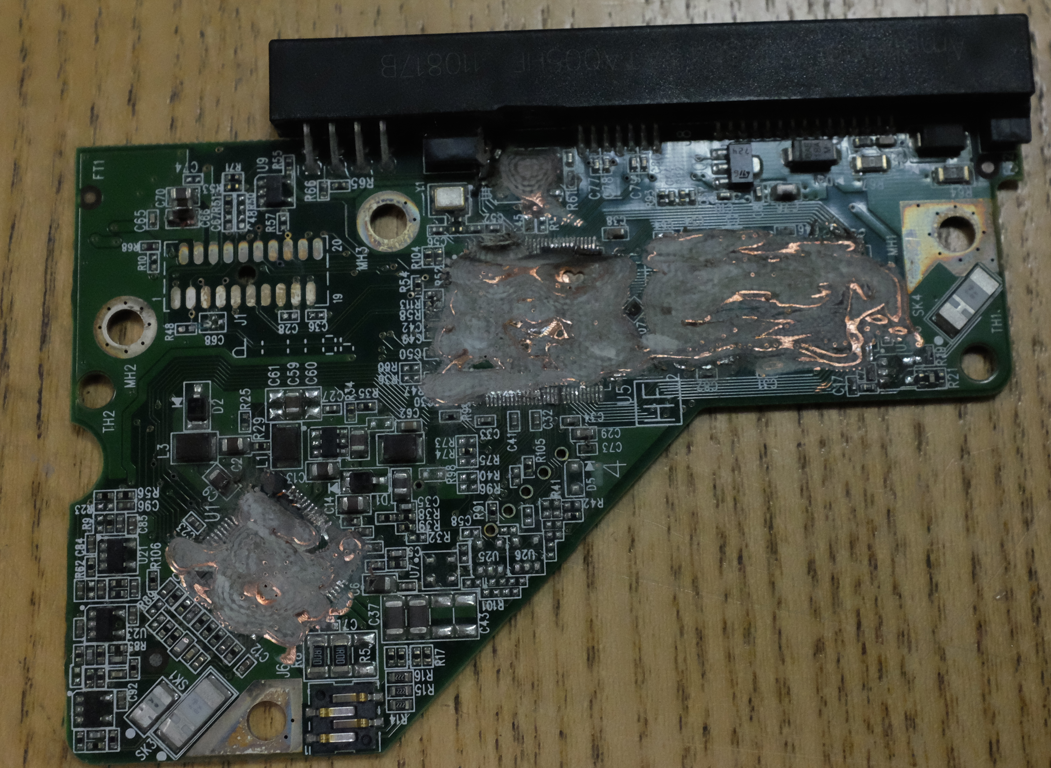
Hard drive controller

Slide 28
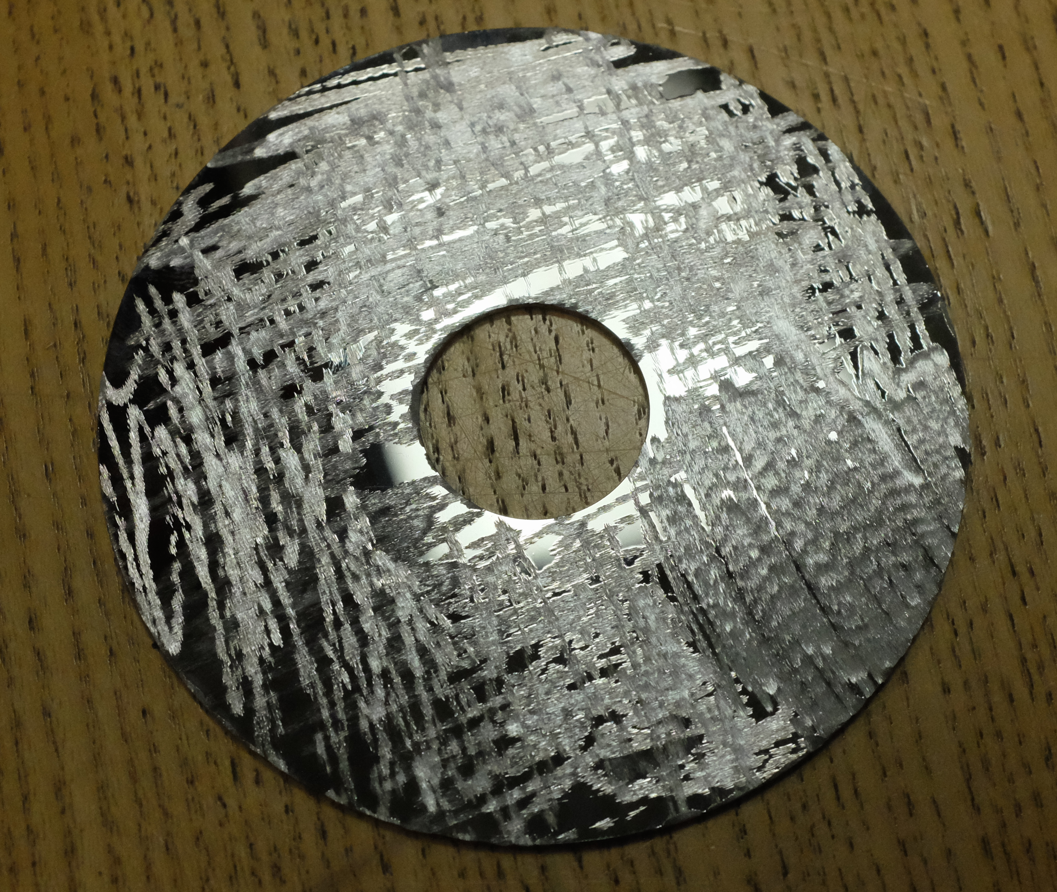
Hard drive platter

Slide 29
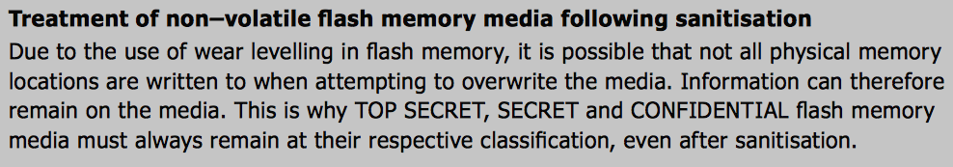
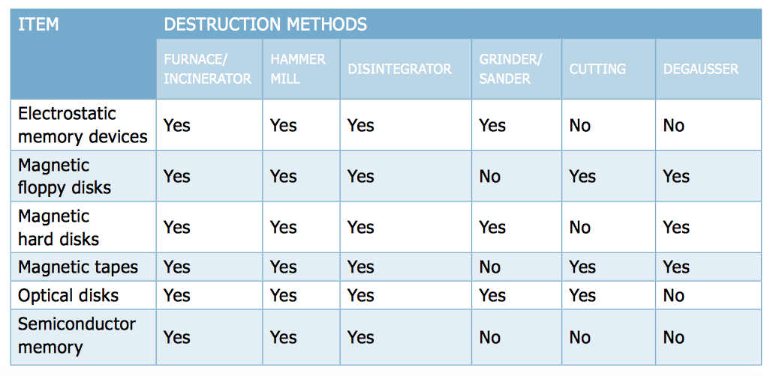
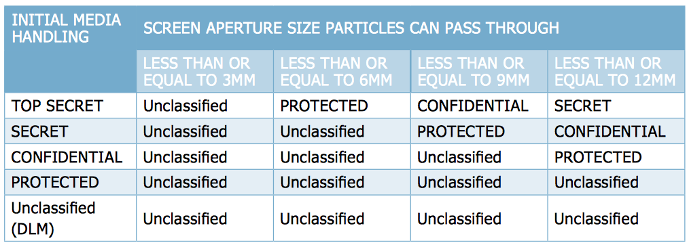
Top Secret Destruction – Australia

Slide 30
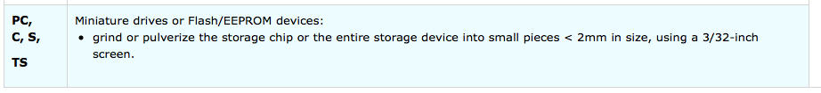
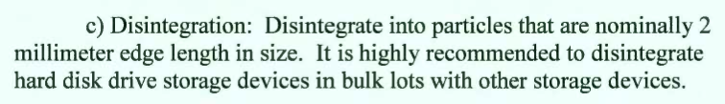
Top Secret Destruction – Canada & USA

Slide 31
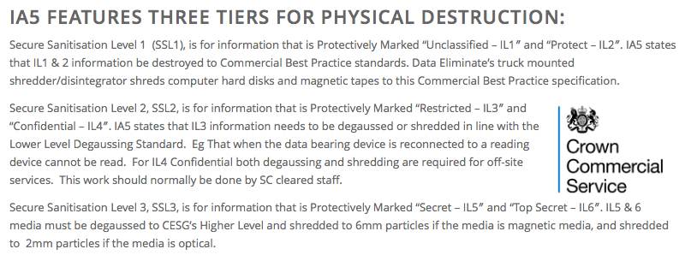
Top Secret Destruction – UK
http://www.secure-data-destruction.co.uk/impact-level/

Slide 32
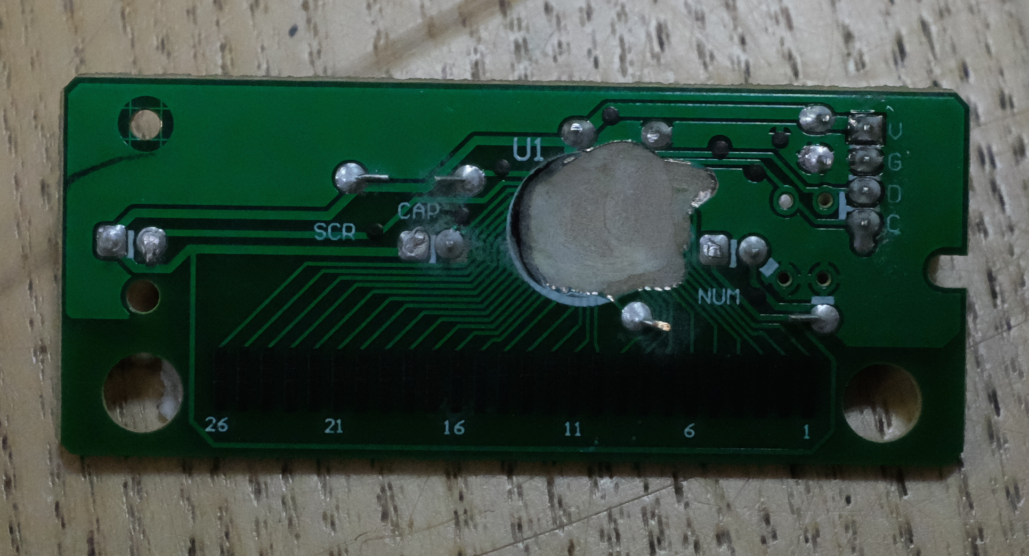
Keyboard Controller

Slide 33
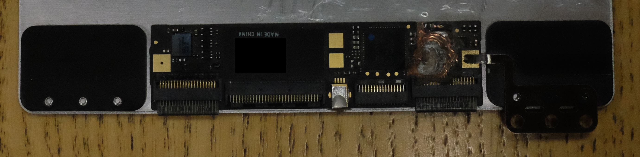
Keyboard and Trackpad Controller

Slide 34
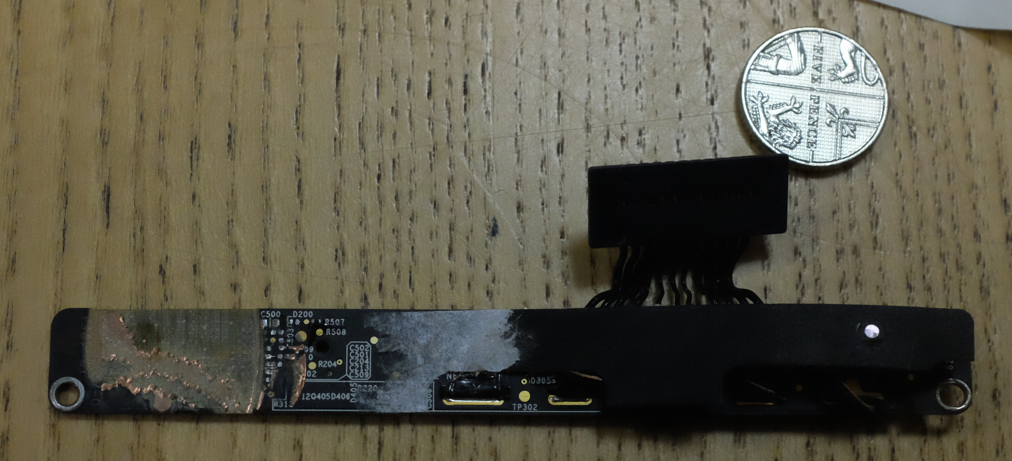
Power Controller

Slide 35
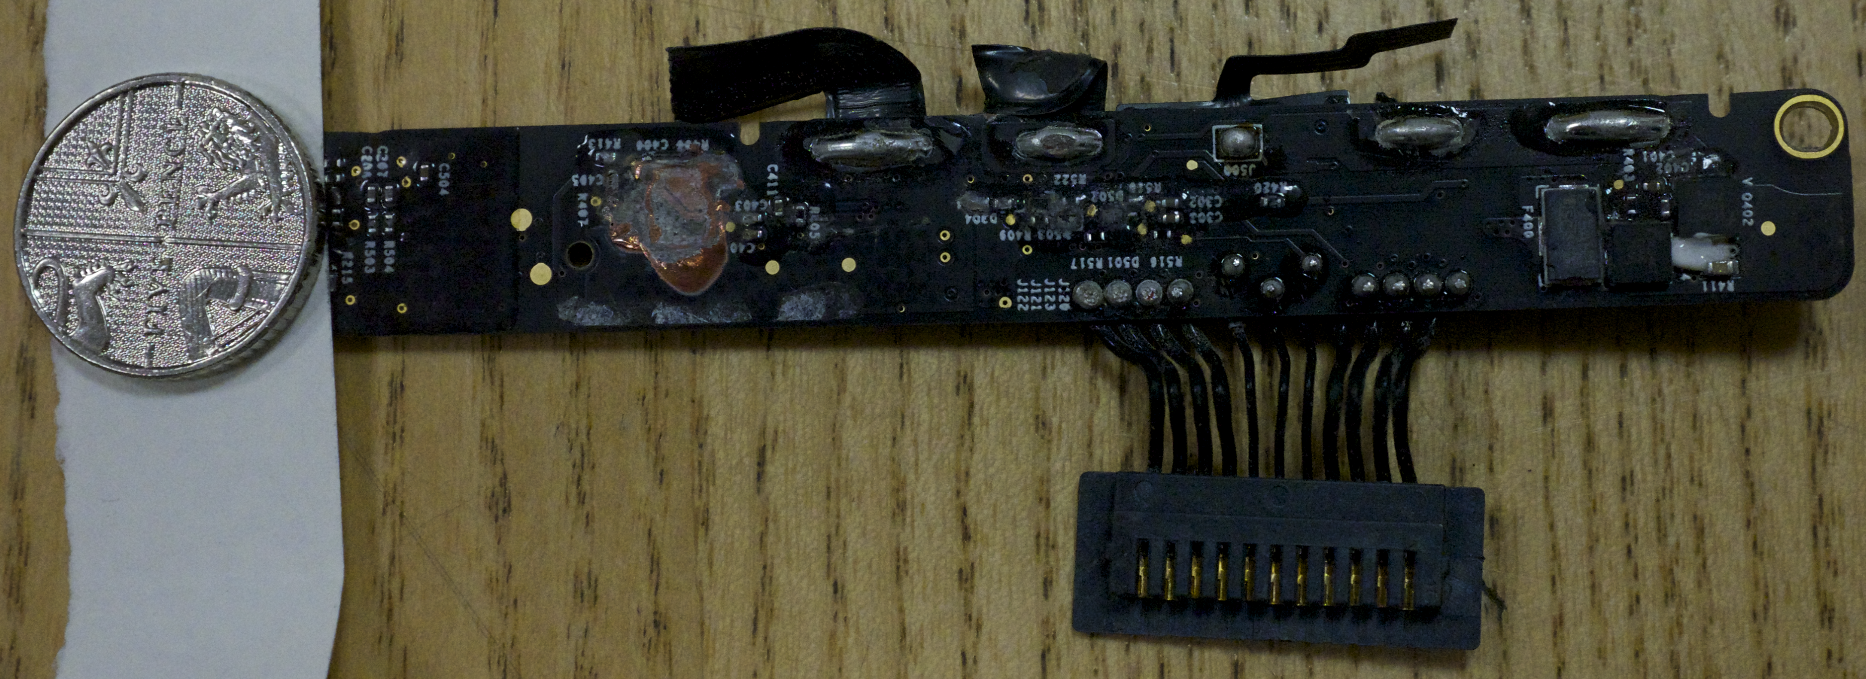
Power Controller

Slide 36
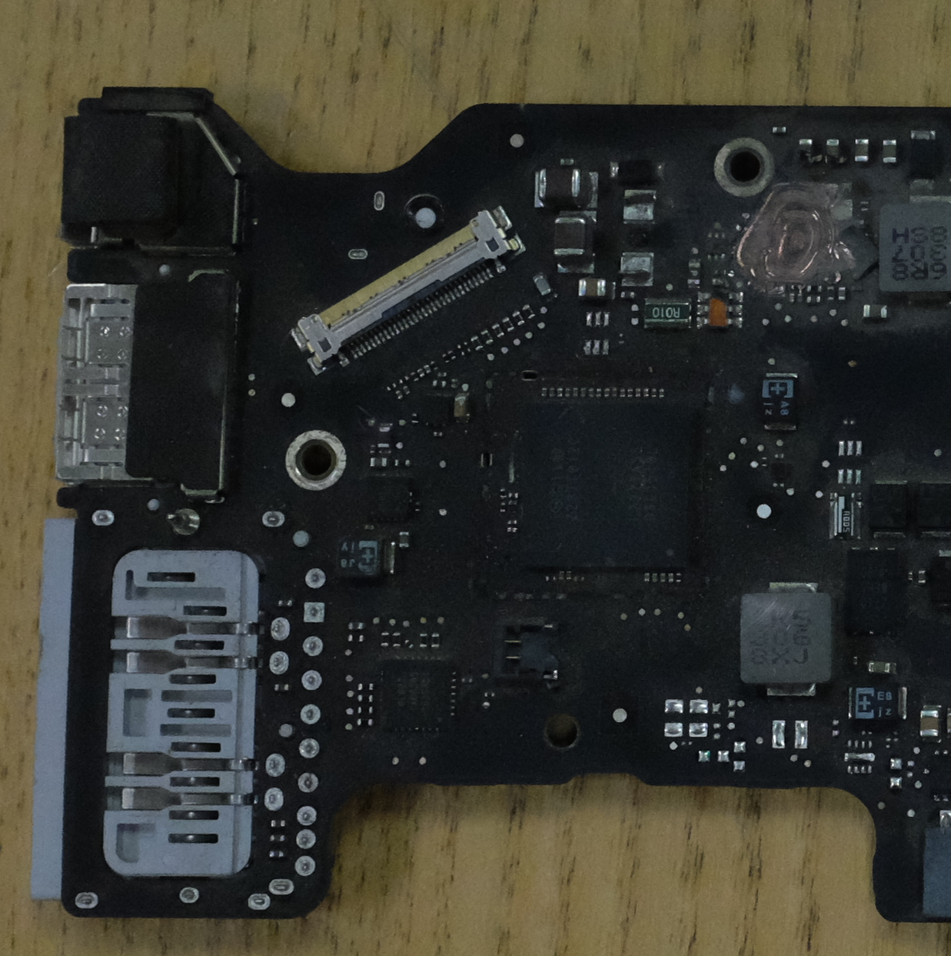
Inverting Converter

Slide 37
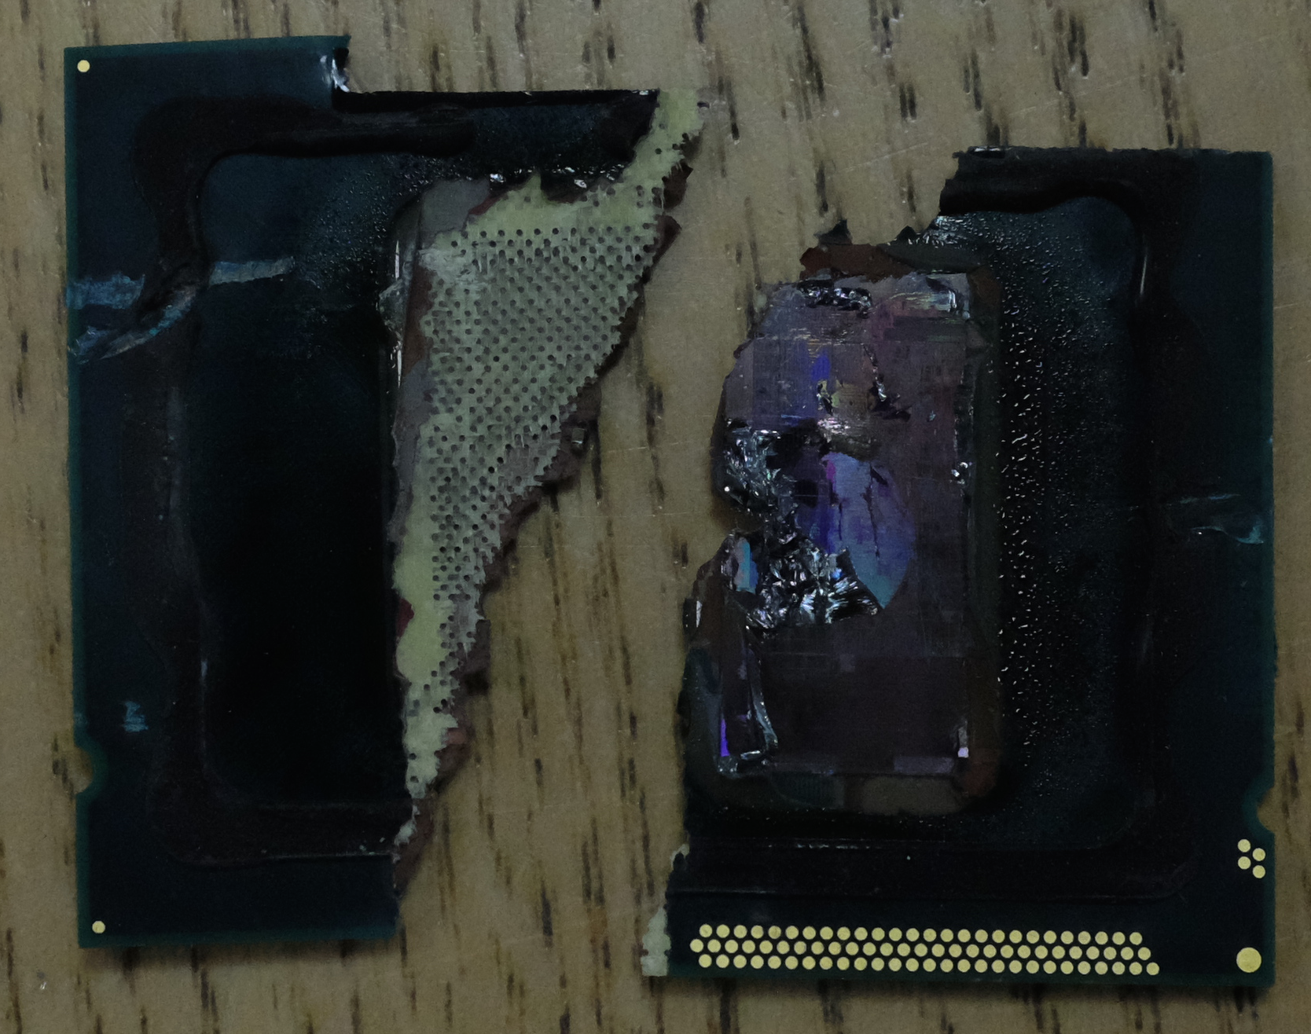
CPU

Slide 38
Inverting Converter

Slide 39
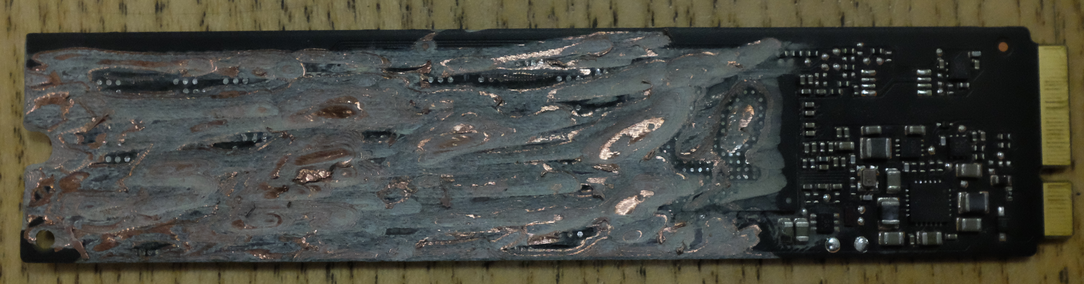
SSD

Slide 40
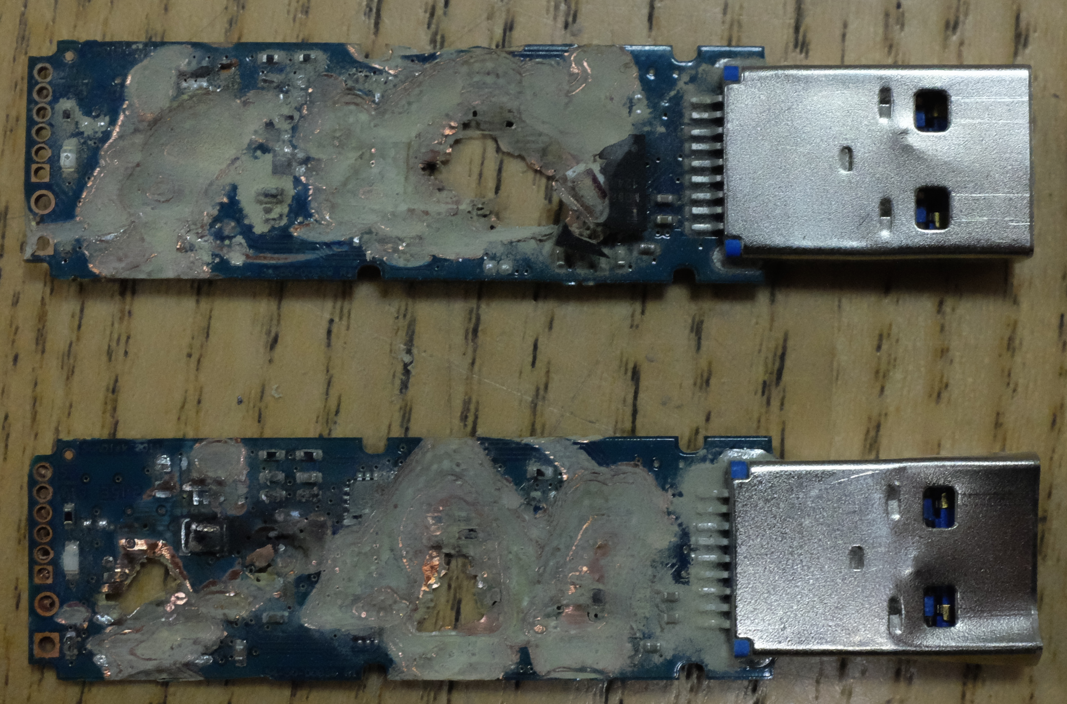
USB Sticks

Slide 41
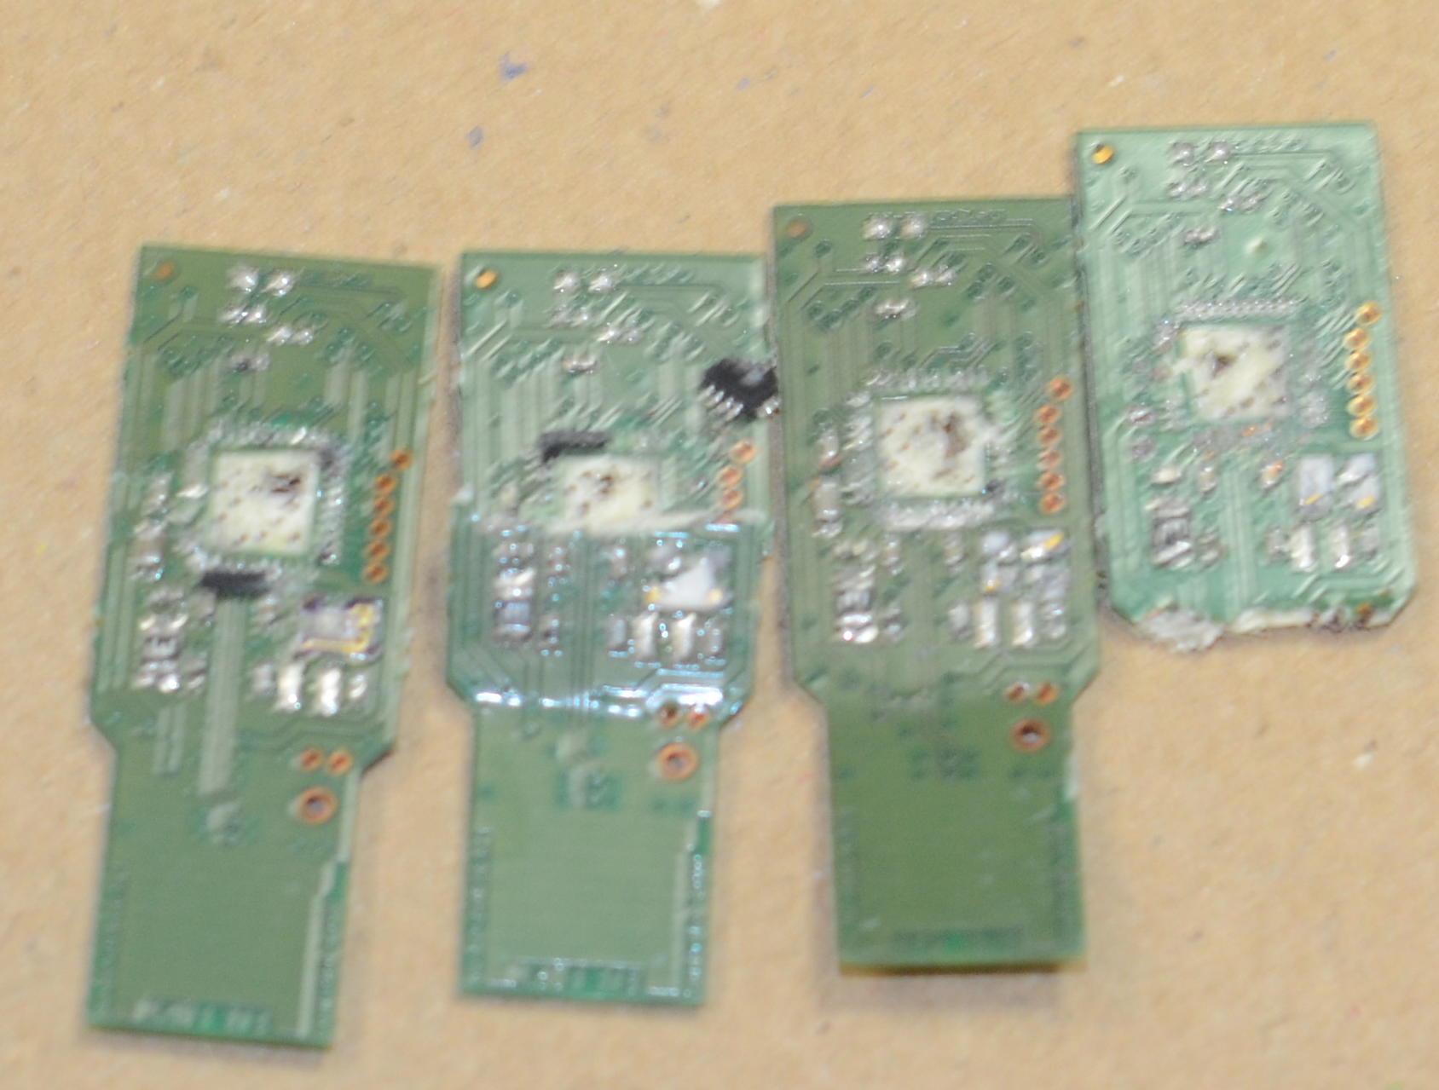
USB Sticks

Slide 42
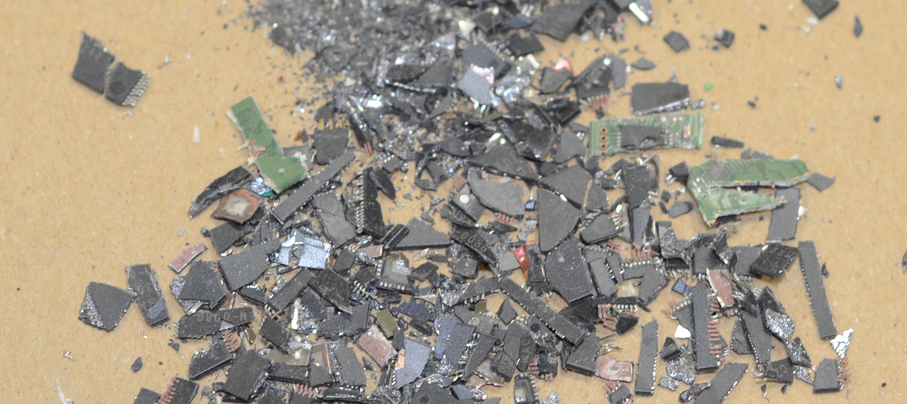
USB Sticks

Slide 43
Recap
GCHQ doesn't trust Apple devices to keep its secrets – should we?
If a component contains Top Secret material it must be destroyed as per the guidelines
Which components contain Top Secret material?
Now we know this for the specific Mac Book Air model in question
What about all other computers?
Notes:
Quote 1 is from someone who claims “it was previously my job (for 3 years) to investigate security breaches and destroy devices”.

Slide 44

ht @csoghoian
Notes:
Quote 1 is from someone who claims “it was previously my job (for 3 years) to investigate security breaches and destroy devices”.

Slide 45
Companies Responses: Dell
Dell sources parts from multiple vendors and our program engineering team confirms the usage of the product and ensures the right electronic design is used for end users purpose as per the global standards.
We regret to inform you that we would not be able to share any circuitry design modules /sourcing details as its Dell confidential.
the USB keyboards provided by Dell are used only as Input device and does not have the capability to store any data or layout data.
Notes:
Quote 1 is from someone who claims “it was previously my job (for 3 years) to investigate security breaches and destroy devices”.

Slide 46

Companies Responses: HP
Proceeding to get the information from HP
Accordingly, we would like to make all interactions between PI and the companies public. Could you please confirm that it is ok for us to do so in relation to HP. We think that this process needs to be as transparent as the end result.
Notes:
Quote 1 is from someone who claims “it was previously my job (for 3 years) to investigate security breaches and destroy devices”.

Slide 47
Theories
All just a show of power and no information can be gleaned from the chips destroyed.
“Back when I worked for Convergys/Apple, one of the main things was we could not bring in our own peripherals to use. Mice, keyboard, etc. The issue is that one, in theory, could customize it for storage covertly and copy customer/client information.”
“I have destroyed the brand new iDevices of senior Government personnel because they plugged it into a classified network to charge it for less than a minute. The law is the law. I actually had a wall of digital devices we had drilled, degaussed etc.”
Obvious to some people what they did.
Notes:
Quote 1 is from someone who claims “it was previously my job (for 3 years) to investigate security breaches and destroy devices”.

Slide 48
Theories
GCHQ were destroying traces of malware they had installed
GCHQ were removing places where their malware could store data
GCHQ were removing places where malware could store data
Some components could store data but others couldn't – misinformation.
Any more from the audience?
Notes:
Quote 1 is from someone who claims “it was previously my job (for 3 years) to investigate security breaches and destroy devices”.

Slide 49
Why is this important?
Empower users with knowledge
Empower users with informed consent
Empower users with control over their information – the essence of privacy
Empower users with verification tools
  Why can't I verify that the firmware on my apple products actually came from apple?
  Backdoors aside, we should be able to know if our firmware is from who we think its from
Make companies even more complicit with mass surveillance if they choose to do so
Notes:
Quote 1 is from someone who claims “it was previously my job (for 3 years) to investigate security breaches and destroy devices”.

Slide 50
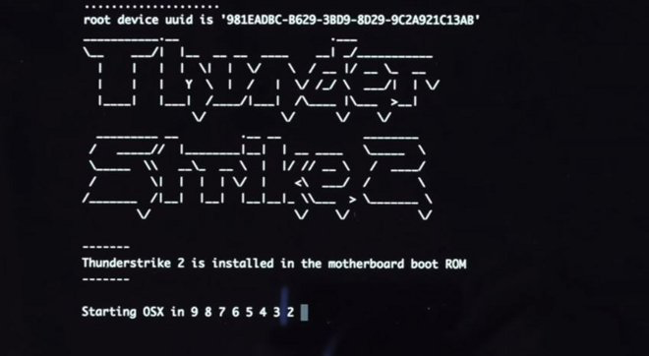
Why is this important?
Notes:
Quote 1 is from someone who claims “it was previously my job (for 3 years) to investigate security breaches and destroy devices”.

Slide 51

Why is this important?
Notes:
Quote 1 is from someone who claims “it was previously my job (for 3 years) to investigate security breaches and destroy devices”.

Slide 52
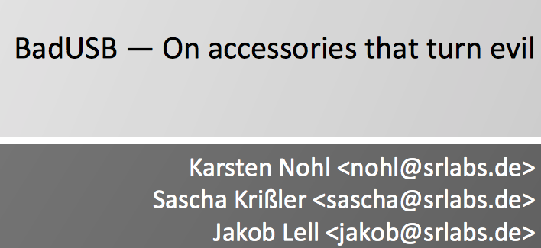
Why is this important?
Notes:
Quote 1 is from someone who claims “it was previously my job (for 3 years) to investigate security breaches and destroy devices”.

Slide 53
Why is this Important?
Empower users with verifiable deletion
Don't want to have to angle grind our products before disposal
This is a global problem
Other work in Central Asia, South America and Africa will benefit from device security
Internet of things
  Greater (unknown) digital footprint
  Greater penetration into our lives
  Greater problems when things go wrong
Notes:
Quote 1 is from someone who claims “it was previously my job (for 3 years) to investigate security breaches and destroy devices”.

Slide 54
Open Questions
GCHQ doesn't trust Apple devices to keep its secrets – should we?
When data is more important that national security e.g life and death, how do we delete data?
How do we know which chips store our sensitive data?
Do we have a right to know?
Do we have a right to delete?
Do we own our devices?
Notes:
Quote 1 is from someone who claims “it was previously my job (for 3 years) to investigate security breaches and destroy devices”.

Slide 55
Questions?
Twitter
  @musalbas
  @richietynan
  @privacyint

